Slide 1

JPA FOR NoSQL
Ways for using JPA and NoSQL together. Contribution for Hibernate OGM project.
FEBRUARY 1, 2017

Slide 2

SERGEY CHERNOLYAS
I have been using Java technologies for 15+ years. During the period, I have got six certificates (4 from Sun/Oracle and 2 from IBM). Also, I got part in several big projects for russian and international companies, like VTB24 (VTB Group), TouchBank (OTP Group).
I have got part in contribution for open source projects since 2016.
SERGEY CHERNOLYAS
Lead Software Engineer

Slide 3
SUBTOPICS
JPA for NoSQL: Why and How?
Hibernate OGM presentation
OrientDB presentation
My contribution to Hibernate OGM project (Integration module for OrientDB)
Notes:
Today, I am going to talk about using JPA in NoSQL world, to present projects Hibernate OGM, OrientDB and my integration module that lets use JPA and OrientDB together.
My speech consists of four subtopics.
I demonstrate examples of using Hibernate OGM with several NoSQL storages. Also I demonstrate OrientDB and my integration module for Hibernate OGM for OrientDB .
Lets start

Slide 4
JPA for NoSQL: Why and How?

Slide 5
JPA for NoSQL: Why and How?
Standard way for declare and describe domain model
Common way for working with entities
One way for working with different storages
Notes:
One of first implementations of ORM (Object-Relation-Mapping) was Entity Beans from EJB2 (specification 1.1 from 1999). So, You can see that idea of ORM for relational databases is old enough. But … What is reasons of it? Everyone knows that relational databases has standard language (SQL) and standard interface for database driver (JDBC). However, ORM tools as middle level have been progressing.
Why?
I think that main reasons are :
Firstly, ORM provides a general way for describe domain model. And secondly, ORM takes care of working with database.
JPA as inheritor of ORM ideas is the most used standard since 2006 (JPA 1.0) . The current version of the specification is 2.1. Now, JPA has several implementations as Hibernate ORM, EclipseLink and Apache OpenJPA in production using.
So, Everything is okey in world of relational databases.
But what about world of NoSQL storages? Can We use same ways with NoSQL storages? Can We use same application with MongoDB and Apache Casandra?

Slide 6

Hibernate OGM presentation

Slide 7
Introduction the project
Main goals
Main achievements
Notes:
The project “Hibernate OGM” was started in 2011.
Main goal of the project is provides one standard access for all NoSQL storages. Target specification for the project is JPA 2.1
Now, achievements of the project are :
supported the most of used types of storages and
8 most popular storages
JPA 2.1 specification implemented mostly

Slide 8
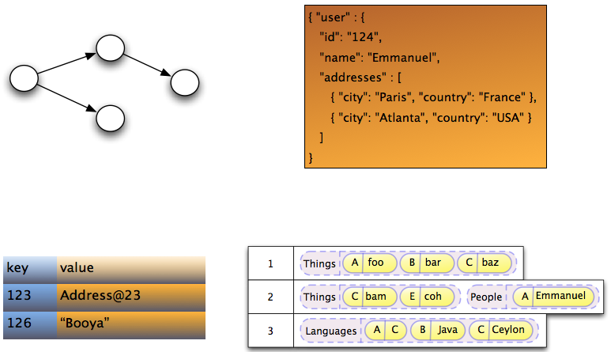
Supported types of storages
Notes:
I get the image from project documentation. You can see that world of NoSQL has many kinds of storing.

Slide 9
Supported types of storages
Graph
Document-oriented
Key-values
Column-oriented
Multi-model (produced in 5.2 release)
Notes:
The project supports graph, key-values, column-oriented and document-oriented types of storages in production version (5.1.0.Final)
Next release will supports multi-model storage.

Slide 10
Supported storages
Infispinian, Ehcache, Redis(Experimental), Apache Ignite (include to release 5.2)
MongoDB, CouchDB(Experimental)
Neo4j
Cassandra(experimental)
OrientDB (include to release 5.2)
Notes:
The slide contains enumeration of supported storages. Storages that selected by italic is included to release 5.2 plan.
Part of storage set has status “experimental”.

Slide 11
Supported features
Data storage | Features
 | Associations | Queries | Transactions | Remote/Embedded
Mongodb | + | Native, JPQL | Emulation | Remote
CouchDB | + | Native | Emulation | Remote
Infispinian | + | JPQL | JTA | Remote/Embedded
Ehcache | + | - | - | Remote
Redis | + | JPQL | Emulation | Remote
Neo4j | + | Native, JPQL | Emulation | Remote/Embedded
Cassandra | + | Native, JPQL | Emulation | Remote
Notes:
The slide contains aggregated information about features for each storage.
Part of storages supports JPQL. The feature implemented by Hibernate Search product.
The most of storages supports transactions by emulation. Part of them has own transaction system. And Hibernate OGM integrates with the system. Other part of storages has not any transactions. In this case, Hibernate OGM emulate transaction by side tools.
Part of integration modules supports embedded mode. For example, Neo4j.
About associations. Now, all integration modules supports all types of associations in JPA 2.1 It “One-To-One”, “Many-To-Many” and so on.

Slide 12
Architecture
em.getTransaction().begin();
em.persist(new Person("name1"));
em.getTransaction().commit();
Hibernate ORM Core
Hibernate OGM Core
4.commit()
3.insertTuple()
2.createTuple()
1.begin()
Hibernate OGM Module for Concrete Storage
GridDialect
DatastorageProvider
Notes:
Time to talk about architecture. Project Hibernate OGM (Object-Grid Mapping) is based on famous Hibernate ORM (Object-Relational Mapping).
What happens than we execute the simple code?
Core of Hibernate ORM defines type of request and redirect the request to core of Hibernate OGM. After it, core of Hibernate OGM loads concrete provider and sends to it sequence of commands to lower level. These commands are:
Create new transaction
Create empty tuple for future entity
Set data of new entity and insert to storage
Commit the transaction.
And concrete data storage provider and grid dialect are doing low-level actions with storage.
The sequence rights for OrientDB integration module. Integration modules for other storages has different sequence.

Slide 13

OrientDB presentation

Slide 14
OrientDB advantages
Developed by Java
Multi-model (document + graph) storage
SQL-like query language
Supports stored procedures (any JSR-223 language)
Multi-master replication
Part of table (cluster, index and global record id) as target for query
Excellent performance (10x faster Neo4j)
Join-less retrieving of relationships
API for many languages and frameworks
Supports own transactions
Notes:
OrientDB is multi-model database combines document-oriented and graph storages. In this way, You can create document as graph node and make link (edge) to other graph node. First release of OrientDB was in 2010 by Luca Garulli.
OrientDB has advantages

Slide 15
OrientDB disadvantages
Small team
Implementation is enough green (snapshot release: 3.0.0)
Notes:
What about disadvantages?
OrientDB team is small and it can not develop new features and fix bugs fastly.
Implementation is enough green.

Slide 16
Integration module for Hibernate OGM presentation

Slide 17
First release supports
Embedded and remote modes
Document model
Transactions by emulation
Associations ( one-to-one, one-to-many, many-to-many )
Embedded objects ( limitedly )

Slide 18
Plans for future releases
Using @RID as primary key for best performance
Graph model
Embedded objects as primary keys
Migration to OrientDB 3

Slide 19
THANK
YOU

Slide 20




CONTACT ME
Sergey_Chernolyas@epam.com
Sergey.chernolyas
schernolyas

